Slide 1
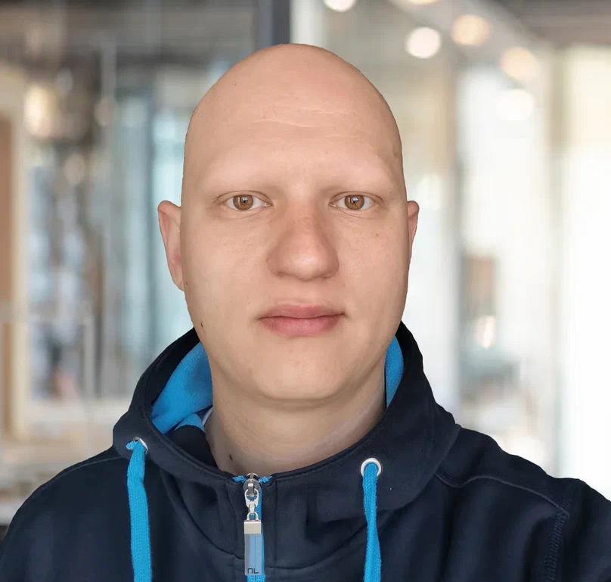
Pavel Purlantov
Software Consultant
Command pattern и MediatR в .NET
Cleaner code, separation of concern and single responsibility

Slide 2
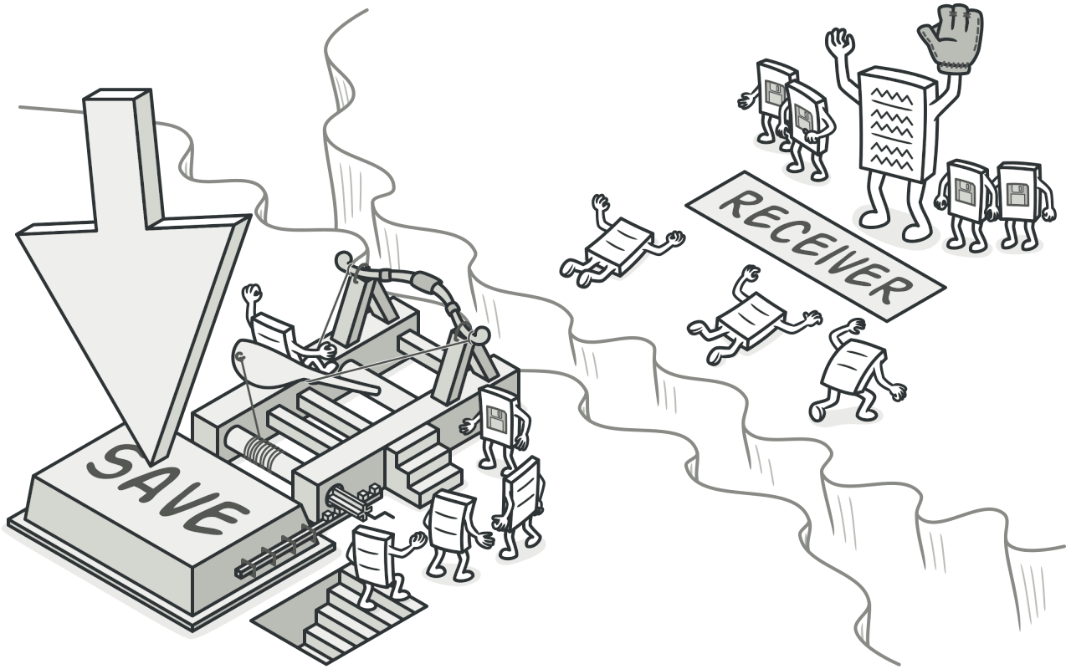

Agenda
What is Command Pattern?
What is MediatR?
What are thin controllers?
How to use MediatR in .NET?
Examples.
Q & A.
Command Pattern
MediatR library

Slide 3
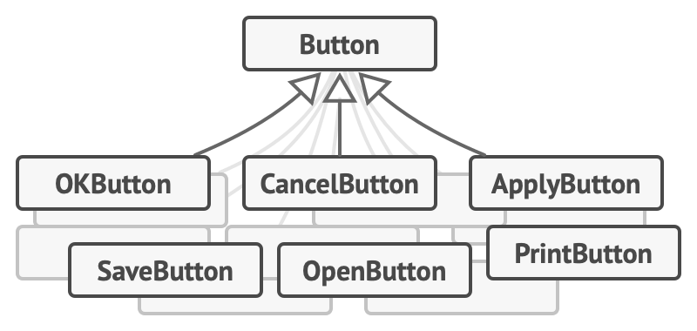
What is Command Pattern?
The command pattern is a data-driven design pattern that falls in the category of behavior patterns.

Slide 4
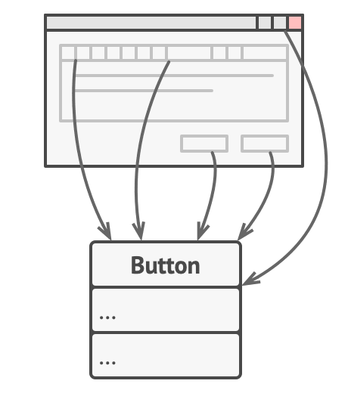
What is the problem?
While all these buttons look similar, they’re all supposed to do different things. Where would you put the code for the various click handlers of these buttons?

Slide 5
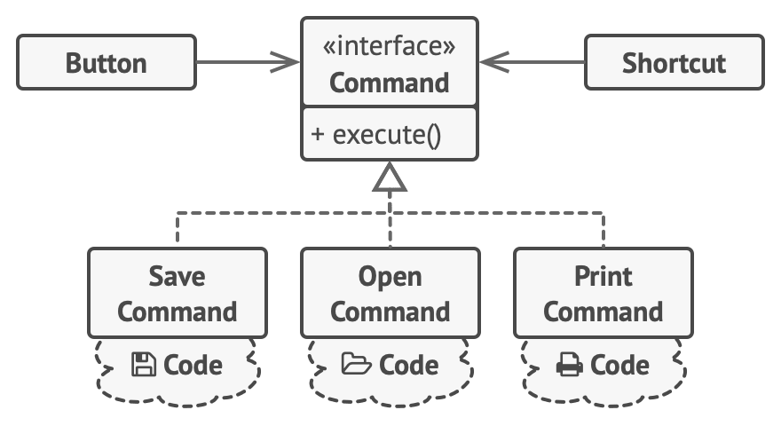
How to solve it?
With the Command pattern, we no longer need all those button subclasses to implement various click behaviors
Layers

Slide 6
The classes and objects participating in this pattern include:
Command (Command)
declares an interface for executing an operation
ConcreteCommand (CalculatorCommand)
defines a binding between a Receiver object and an action
implements Execute by invoking the corresponding operation(s) on the Receiver
Client (CommandApp)
creates a ConcreteCommand object and sets its receiver
Invoker (User)
asks the command to carry out the request
Receiver (Calculator)
knows how to perform the operations associated with carrying out the request.

Slide 7
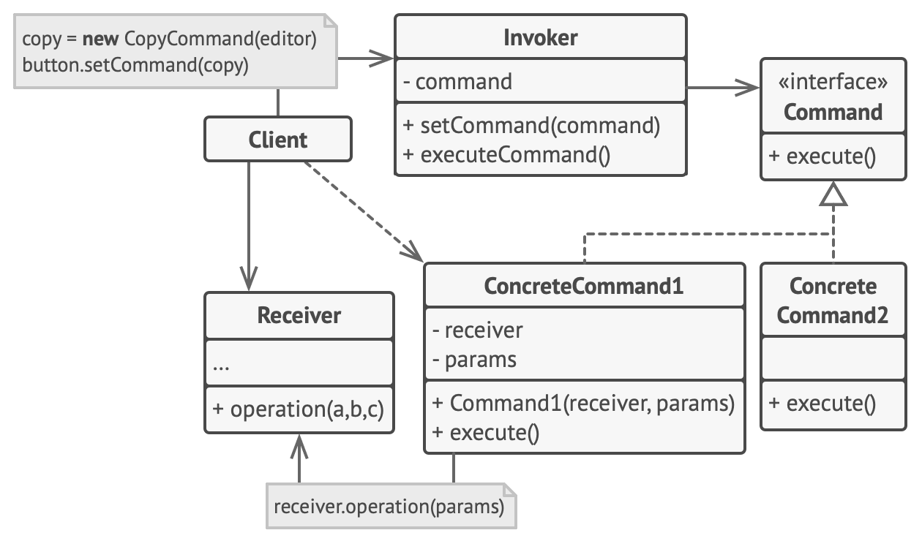

Slide 8
Message
Main
Broker
IMessageCommand
EmailMessage Command
SMSMessage Command

Slide 9
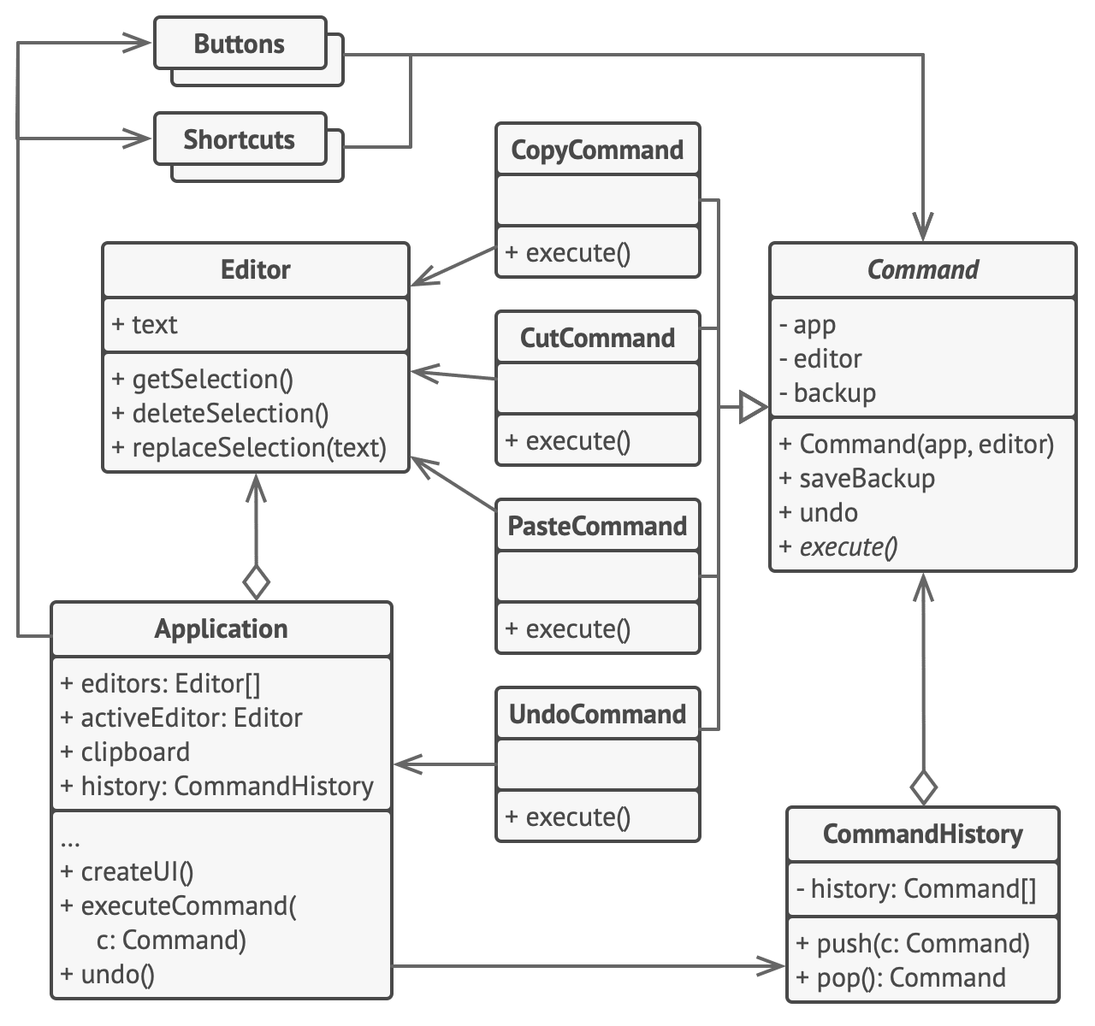

Slide 10
Example DEMO

Slide 11
What is MediatR?
Nuget package
Low-ambition library trying to solve a simple problem — decoupling the in-process sending of messages from handling messages. Cross-platform, supporting
Supports request/response, commands, queries, notifications and events, synchronous and async with intelligent dispatching via C# generic variance.

Slide 12
How to use MediatR in .NET?
How to install
notes

Slide 13
What are thin controllers?
[HttpGet]
public async Task<InfoResponse> GetInfo(InfoRequest request)
{
InfoResponse response = await _mediator.Send(request);
if (response == null)
{
return NotFound();
}
return response;
}

Slide 14
Examples
Demo

Slide 15
Q & A
Please ask and I will answer ☺

Slide 16




Contacts:
Linkedin profile
Facebook profile
Github profile
Instagram profile

